Slide 1
The Frontiers
HEALTH
SECURITY
Leading one health to achieve whole health
Innovating for secure and resilient communities
FRONTIER AREAS
ARTIFICIAL INTELLIGENCE
QUANTUM
Advancing the quantum leap
Harnessing artificial intelligence for intelligence augmentation

Slide 2
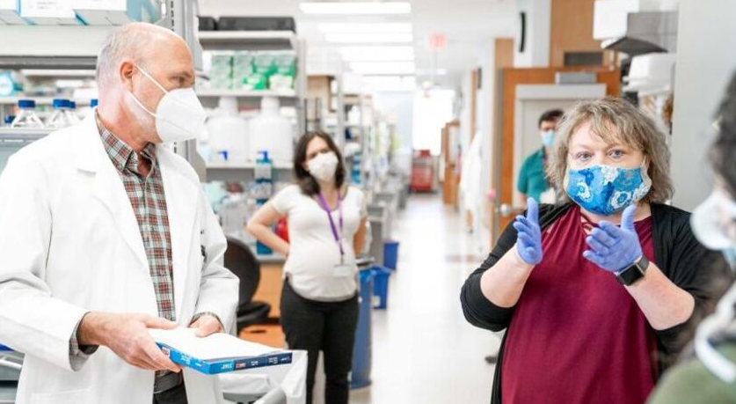
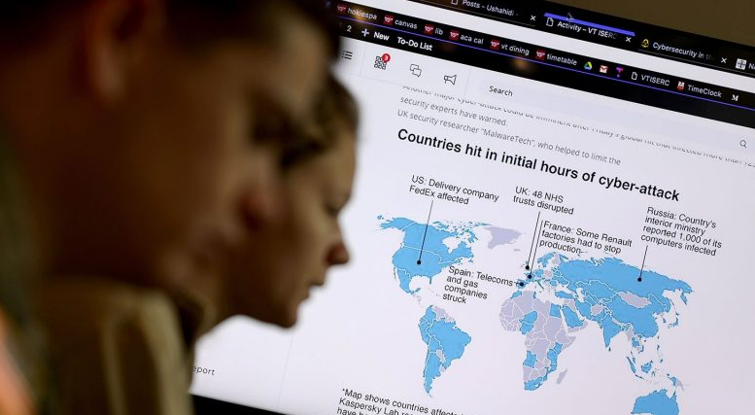
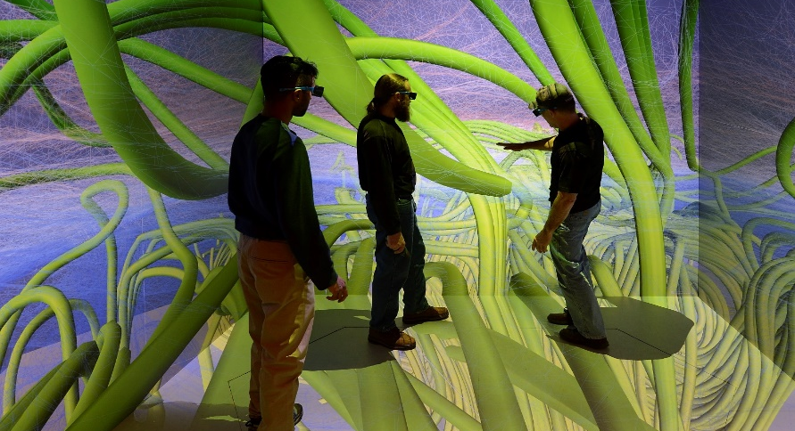
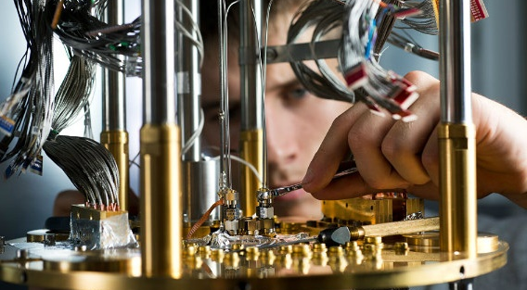
The Research Frontiers
HEALTH
SECURITY
ARTIFICIAL INTELLIGENCE
QUANTUM

Slide 3
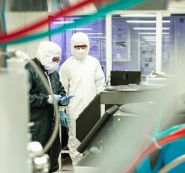
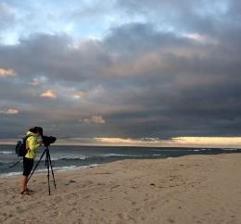
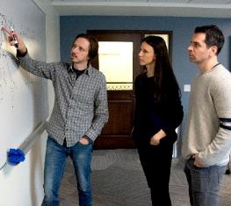
The Research Frontiers
HEALTH
SECURITY
Leading one health to achieve whole health
Innovating for secure and resilient communities
Changing the paradigm from a focus on disease and symptoms to one of whole health, integrating intersections of animal, environment, and human health and building in communities and systems to empower multifaceted well-being.
Ensuring communities are prepared to face global threats, from climate change to natural disasters to national defense, through advances in preparation, defense, mitigation, and recovery.
ARTIFICIAL INTELLIGENCE
QUANTUM
Harnessing artificial intelligence for intelligence augmentation
Advancing the quantum leap
With an unparalleled transdisciplinary focus, accelerating the integration of quantum technologies across society, realizing unprecedented computing and communication capabilities and restructuring our social framework.
Building on expertise in AI and data science, systems engineering, neuroscience, human factors, robotics, immersive visualization, and education, among others, to accelerate human-technology partnerships towards seamless augmentation, ethically and sustainably.

Slide 4
The Research Frontiers
HEALTH
SECURITY
Leading one health to achieve whole health
Innovating for secure and resilient communities
ARTIFICIAL INTELLIGENCE
QUANTUM
Harnessing artificial intelligence for intelligence augmentation
Advancing the quantum leap

Slide 5
The Research Frontiers
HEALTH
Leading one health to achieve whole health
Changing the paradigm from a focus on disease and symptoms to one of whole health, integrating intersections of animal, environment, and human health and building in communities and systems to empower multifaceted well-being.

Slide 6
The Research Frontiers
ARTIFICIAL INTELLIGENCE
Harnessing artificial intelligence for intelligence augmentation
Building on expertise in AI and data science, systems engineering, neuroscience, human factors, robotics, immersive visualization, and education, among others, to accelerate human-technology partnerships towards seamless augmentation, ethically and sustainably.

Slide 7
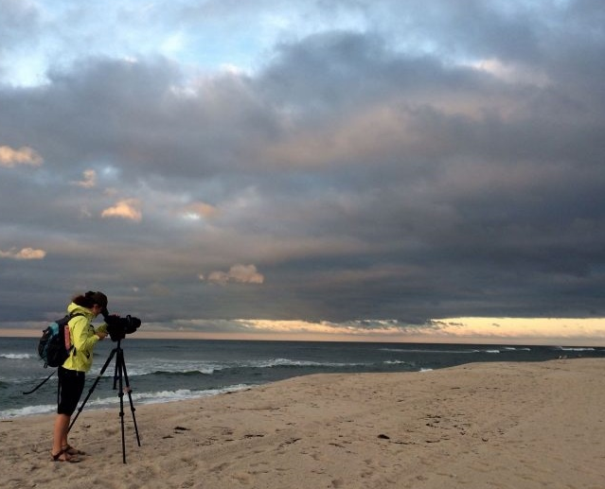
The Research Frontiers
SECURITY
Innovating for secure and resilient communities
Ensuring communities are prepared to face global threats, from climate change to natural disasters to national defense, through advances in preparation, defense, mitigation, and recovery.

Slide 8
The Research Frontiers
QUANTUM
Advancing the quantum leap
With an unparalleled transdisciplinary focus, accelerating the integration of quantum technologies across society, realizing unprecedented computing and communication capabilities and restructuring our social framework.

